Slide 1
Trailbot
Group 14: Brandon Christler, Michael Hitchcock, Garrett Monast, Yifan Wu

Slide 2
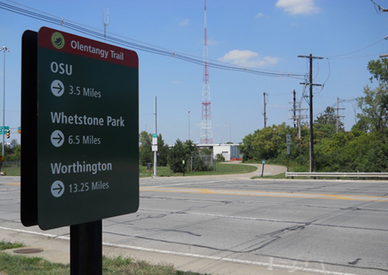
Topic Outline
Needs Statement
Proposed Solution
Preliminary High-Level Design
Component-Level Design
Progress and Issues
Future Plans
Schedule (Gantt Chart, WBS)
Conclusion
Q & A

Slide 3
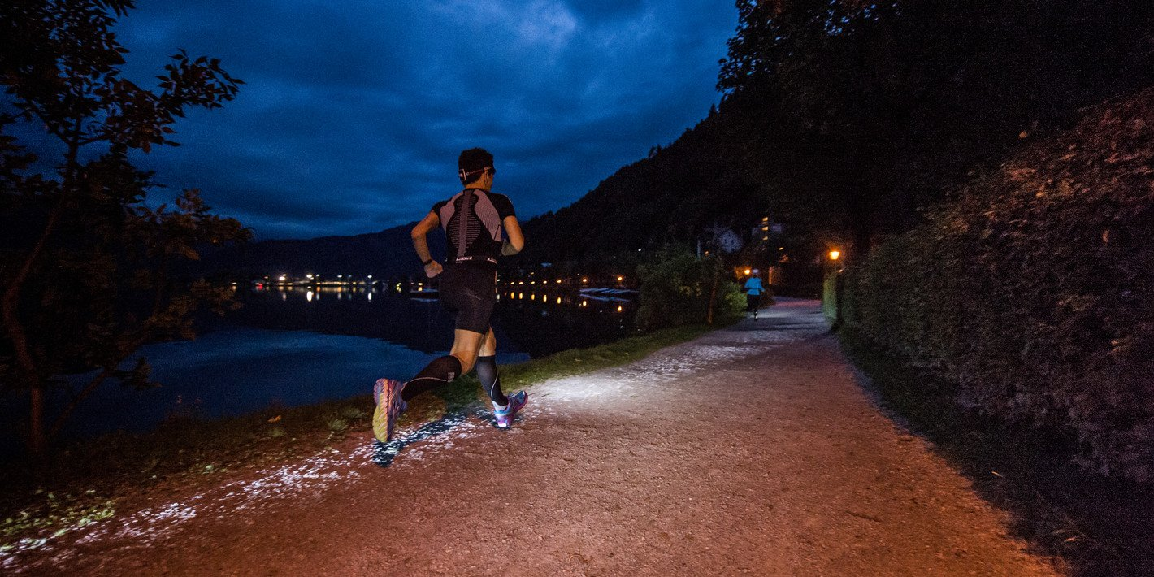
Needs Statement
Joggers sometimes like to, or have to, run at night or during hours of limited light due to their schedules.
Visibility is not always great.
Joggers must carry items, such as water bottles, phones, and chargers.
Phone-charging capability desired.

Slide 4
Solution
A user-tracking robot presents a useful solution idea. The robot will:
Follow the user using infrared (IR) sensors--more accurate than GPS.
LED light racks will be mounted to chassis, to provide light to user.
Robot will stop for, and attempt to circumnavigate, obstacles in its path.
Phone-charging dock will be mounted to chassis.
Carrier(s) for small items (e.g. water bottle, keys) will be mounted to chassis.
Maintain appropriate distances when moving (jogging) and stopped.
Will be designed for tracks, paved trails, and finished roads in mind.
User will wear a clip-on “fob,” which houses a transmitting IR beacon.

Slide 5
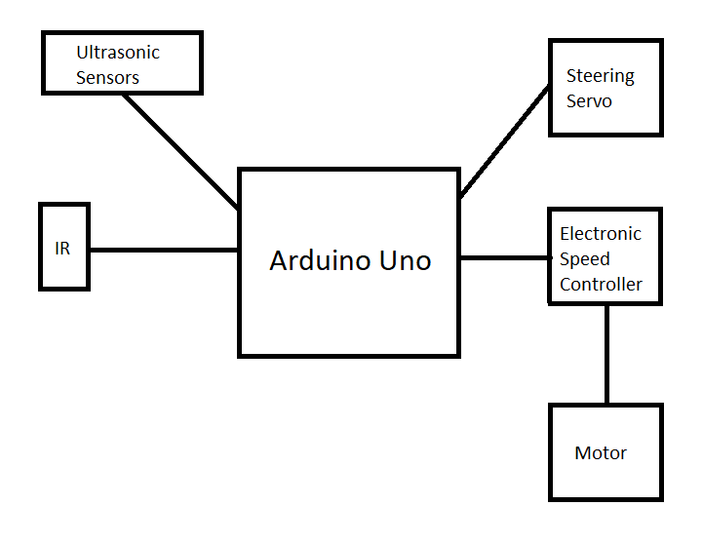
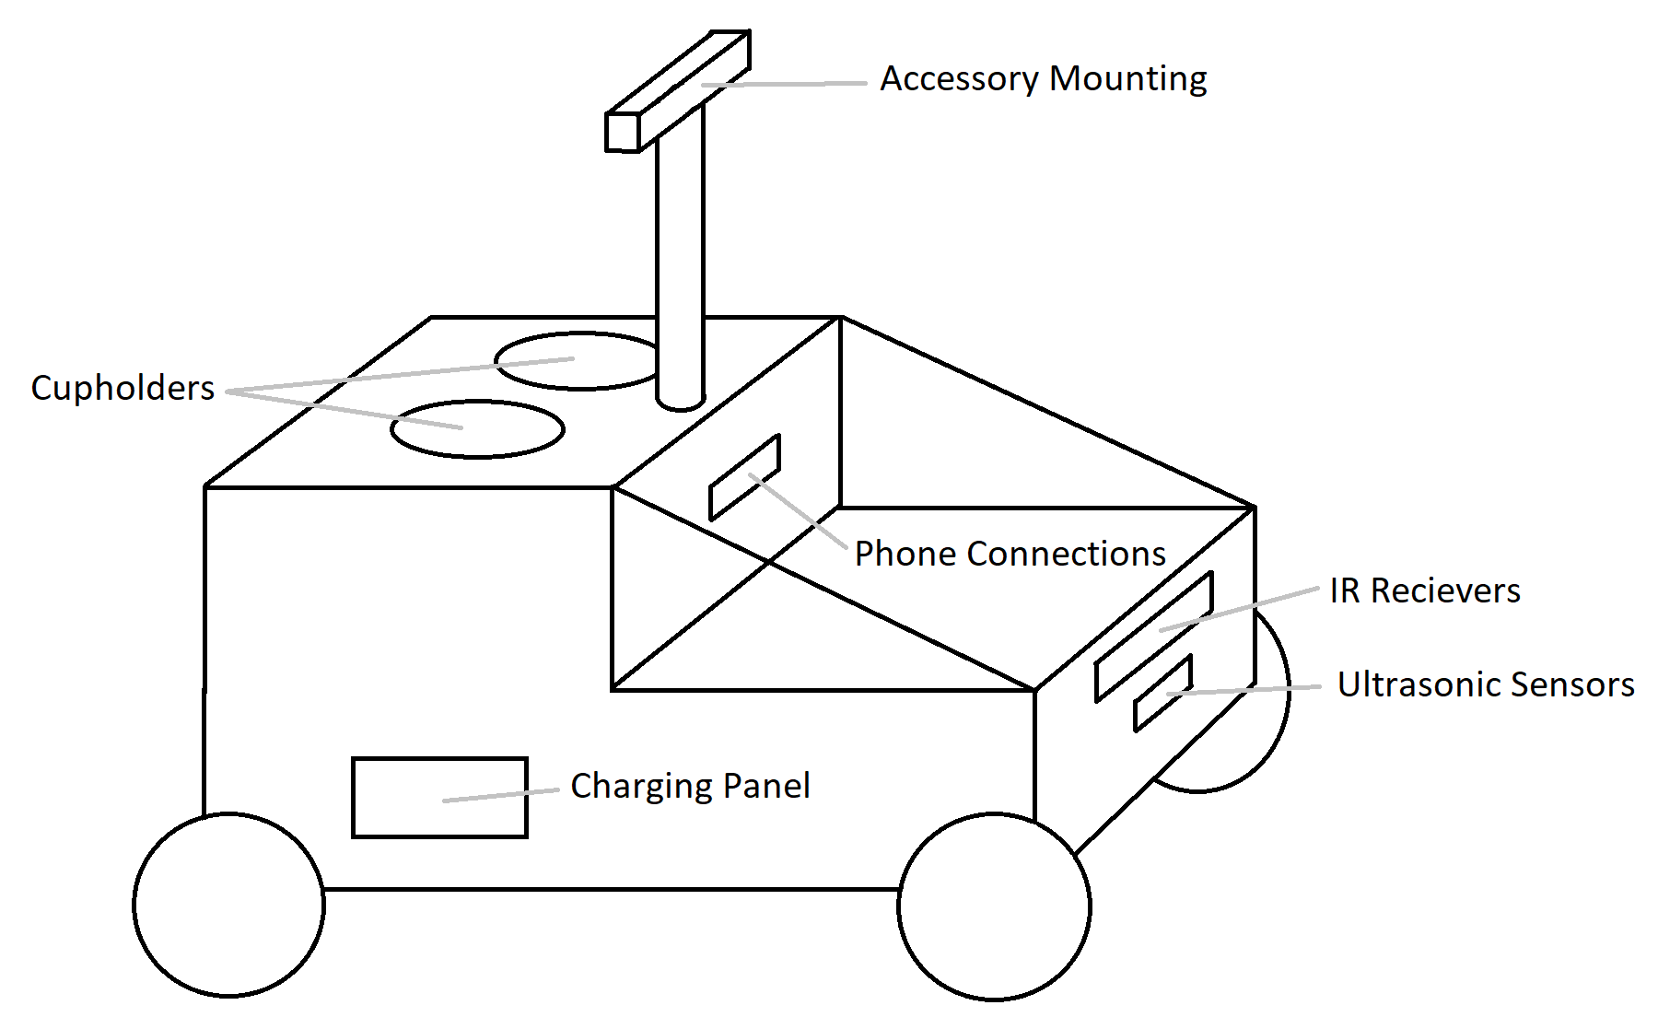
Preliminary High-Level Design

Slide 6
Progress and Issues
Progress
Primary components obtained: Arduino Uno, motor shield, motors, chassis, ultrasonic/IR sensors.
Model chassis assembled.
Basic “obstacle avoidance” achieved; motors run when unobstructed, and stop immediately when an obstacle is detected.
Final chassis selected.
Directional IR module designed, not yet incorporated

Slide 7
Progress and Issues (cont’d)
Issues
Current motor driver (full shield) takes up most of the pins on the Arduino, and makes “extra” pins unavailable. Modification can be done to resolve this, but ESCs would not pose this problem.
Current motor driver on final chassis is likely designed to recognize specific signals from inherent microprocessor (e.g. voltage level, PWM). Motor driver will be researched, if possible, to determine interface options with Arduino. If interfacing is not feasible, a new motor driver (perhaps the shield on the model) will be utilized.
9V batteries do not draw sufficient current to power motors, so larger batteries will be needed (i.e. batteries capable of discharging more current). RESOLVED

Slide 8
Future Plans
Develop and integrate directional IR receiver module.
Expand code to include obstacle circumnavigation and user-tracking.
Incorporate control electronics onto final chassis.
Determine and install chassis covering.
Discuss and determine mounting strategy for LED rack and docking station.

Slide 9
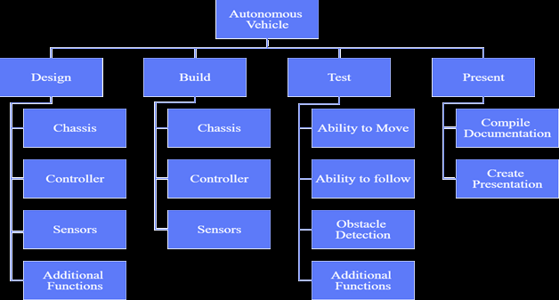
Work Breakdown

Slide 10
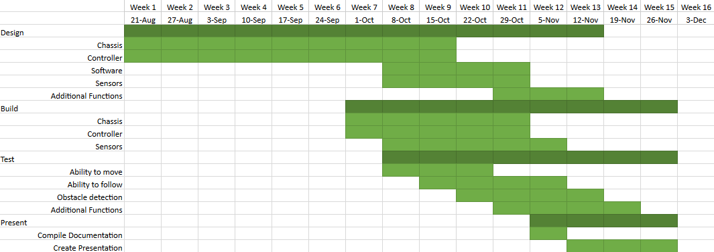
Schedule

Slide 11
Conclusion
Trailbot is a simple, user-tracking, obstacle-avoiding robot, designed specifically for paved trails, tracks, and roads, which will provide solutions to several problems encountered by nighttime joggers.
The team will construct a final design that is reliable, weather-resistant, low-cost, and relatively low-weight, with a battery life of at least one hour.
The design will combine the versatility and customizability of Arduino with the rugged, durable design of a commercial RC car chassis.

Slide 12
Questions?

